Slide 1
Vulnerabilities with DNS and DNS Security
Tirthankar Ghosh

Slide 2
DNS Resolvers
Stub resolver
Resides in every host that sends a recursive query to the real resolver
Real resolver
Resides in the DNS server, sends an iterative query for resolving a domain name

Slide 3
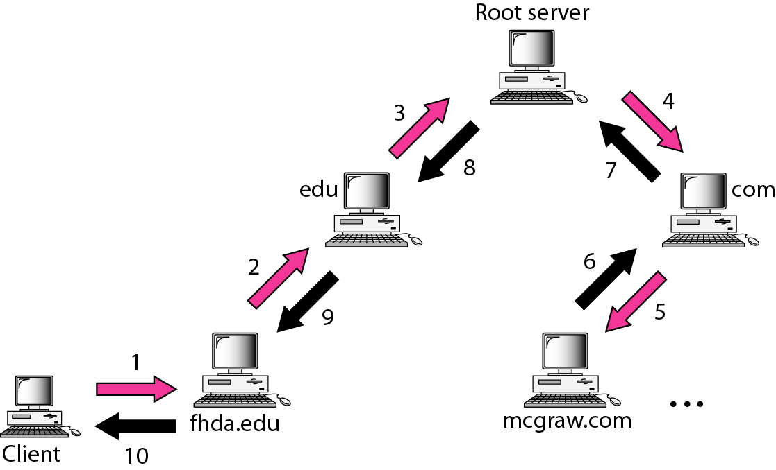
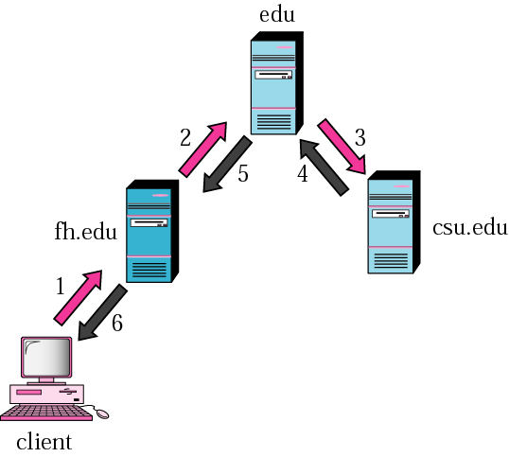
Recursive Resolution

Slide 4
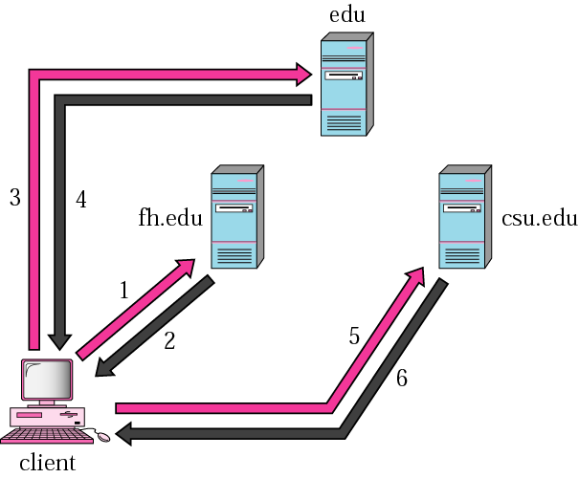
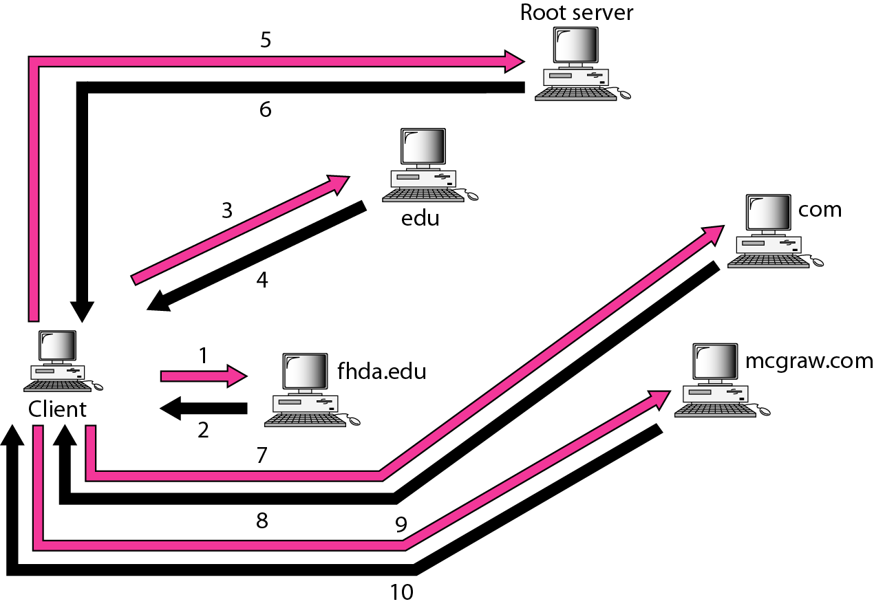
Iterative Resolution

Slide 5
Caching
A server caches the mapping information that it receives from other servers.
When it sends a response to a client from its cache, it marks it as unauthoritative.
Problem with this is that the information from the cache may be outdated.
Solution: each authoritative server adds a TTL (time-to-live) to each mapping (indicates how long other servers can put the information in cache).
After TTL expires, the mapping is invalid and query is sent to the authoritative server.

Slide 6
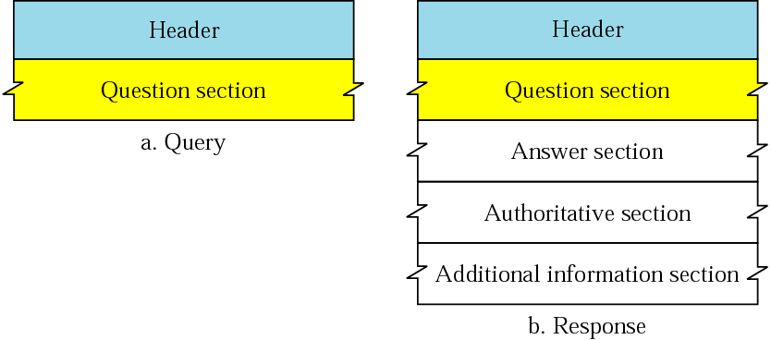
DNS Messages

Slide 7
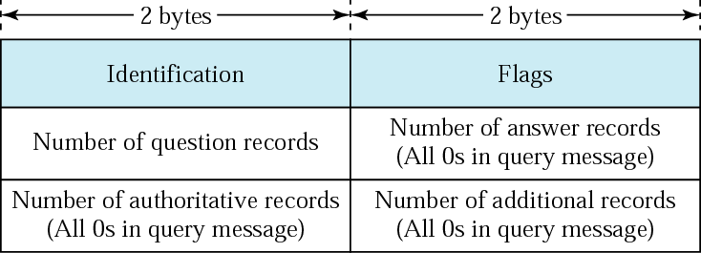
DNS Messages (cont’d)
Header Format
Identification is used by client to match the response with the query. Client uses a different id each time it sends a query, server duplicates this number in the corresponding response.
Flags: a collection of subfield that define the type of message, type of resolution (iterative or recursive), etc.

Slide 8
DNS Messages (cont’d)
Question section: Contains one or more question records.
Answer section: Includes the answer from the server to the client.
Authoritative section: Gives information about authoritative servers.
Additional Information: Any other information that may help the resolver.

Slide 9
Dynamic DNS
Whenever there is a change in mapping, the master file needs to be updated.
It is done dynamically.
Whenever a mapping occurs, the information is sent by the DHCP server to a primary DNS server.
The primary server updates its zone, and notifies the secondary servers either actively (by sending message) or passively (responding to secondary servers’ queries).

Slide 10
Vulnerabilities with DNS
DNS messages are not authenticated, leading to fake replies from attackers
DNS cache poisoning

Slide 11
DNS Sec

Slide 12
History
1983 - Paul Mockapetris invents the DNS and implements the first server: Jeeves.
1986 - Formal IETF Internet Standard. Two RFC's describe DNS: 1034 and 1035.
1988 - DNS begins to catch on the Internet.
1990 - Steven Bellovin discovers a major flaw in the DNS 2. As DNS is already widely deployed on the Internet, the report is kept secret until 1995. In those years research is started on a more secure replacement of DNS.
1995 - The article from Bellovin is published and DNSSEC (as it became known) becomes a topic within the IETF.
1997 - RFC2065, a predecessor of 2535, is published.
1999 - RFC2535 is published by the IETF. The DNSSEC protocol looks to be finally finished. BIND9 is developed to be the first DNSSEC capable implementation. 1999-2001 - Although the RFC is finished and BIND is DNSSEC ready, deployment is stalling.

Slide 13
History (cont’d)
2001 - Experiments show that the key handling in RFC2535 is causing operational problems that would make deployment difficult if not impossible. After various ideas and drafts a new record was proposed: the DS RR, Delegation Signer resource record.
It is decided to rewrite 2535 into three new drafts:
draft-ietf-dnsext-dnssec-intro - a introduction into DNSSEC
draft-ietf-dnsext-dnssec-records - introduces the new records
draft-ietf-dnsext-dnssec-protocol - details the protocol changes

Slide 14
History (cont’d)
2005 March - The RFC's are published:
RFC 4033 - DNS Security Introduction and Requirements
RFC 4034 - Resource Records for the DNS Security Extensions
RFC 4035 - Protocol Modifications for the DNS Security Extensions
2005 October - Sweden (.SE) enables DNSSEC in their zone. This make .SE the first ccTLD to deploy DNSSEC.

Slide 15
What DNSSec Does
Origin authentication
Data integrity
Does not provide:
confidentiality

Slide 16
DNSSec Operation
Adds four new resource records:
Resource Record Signature (RRSIG)
DNS Public Key (DNSKEY)
Delegation Signer (DS)
Next Secure (NSEC)

Slide 17
DNSSec Operation (cont’d)
RRSIG: each DNS response has an RRSIG record that is a digital signature of the answer set
DNSKEY: used to verify the digital signature by locating the correct public key
DS: used to authenticate the DNSKEYs using a chain of trust
NSEC: used against spoofing

Slide 18
Data Origin Authentication and Data Integrity
Provides authentication by associating cryptographically generated digital signatures with DNS RRsets.
These digital signatures are stored in new resource record, RRSIG.
If a security-aware resolver can reliably learn a zone’s public key, it can authenticate that zone’s signed data.

Slide 19
Origin Authentication and Data Integrity (cont’d)
A security-aware resolver can learn a zone’s public key either by having a trust anchor configured, or by normal DNS resolution.
For normal DNS resolution, public keys are stored in a new type of resource record, called DNSKEY RR.

Slide 20
NSEC Record
The NSEC record allows a security-aware resolver to authenticate a negative reply for either name or type non-existence with the same mechanism used to authenticate other DNS replies.

Slide 21
What DNSSec Does Not Provide
Confidentiality
Access control mechanism
Protection against denial of service attacks

